Slide 1
Section 0.1
“Before Calculus” Functions

Slide 2
All graphics are attributed to:
Calculus,10/E by Howard Anton, Irl Bivens, and Stephen Davis
Copyright © 2009 by John Wiley & Sons, Inc. All rights reserved.

Slide 3
Definition of a Function
You may remember from earlier courses that a function exists when each x value has one y value.
You can also recognize a function from the graph by using the vertical line test.
Remember, x is always the independent variable (values make up the domain) and y is the dependent variable (values make up the range).

Slide 4


Definition 0.1.1 (p. 1)
Definition 0.1.2 (p. 2)

Slide 5
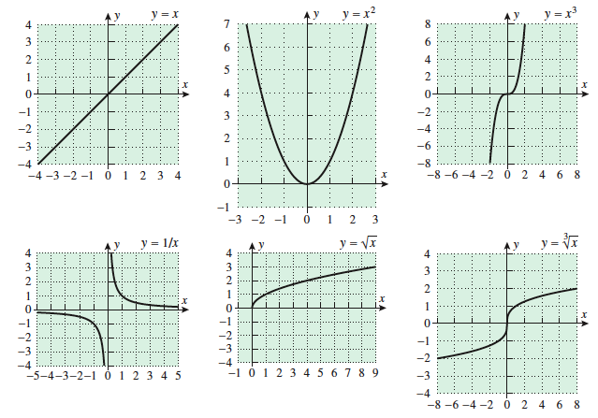
The following are all functions

Slide 6
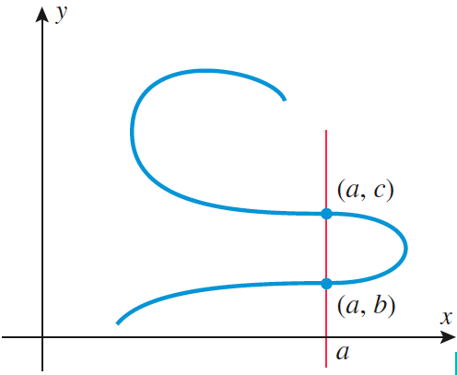
This is not a function because it fails the vertical line test at x=a and other x values.

Slide 7
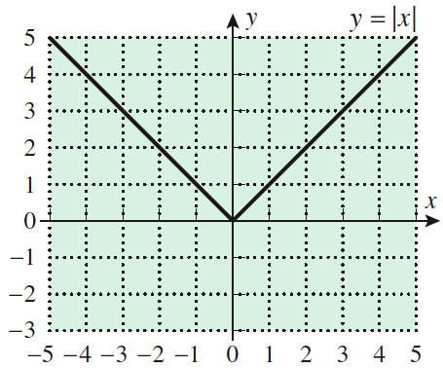
The Absolute Value Function – measures distance from the origin
You may remember graphing y = ІxІ.

Slide 8
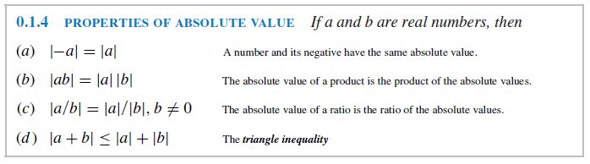
Each x has only one y and it passes the vertical line test, so it is a function.
We will use the following properties of absolute value throughout the year, especially a & b.

Slide 9
Piecewise-Defined Functions
The absolute value function f(x) = ІxІ or y = ІxІ is an example of a piecewise function because the formula changes depending upon the value of x. On the left side, the equation is y = -x where x < 0. On the right side, the equation is y = x where x > 0. They are pieces of two functions combined together in your graph with a breakpoint at x=0.
See page 6 in your book for more examples.

Slide 10
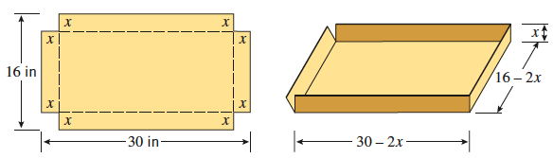
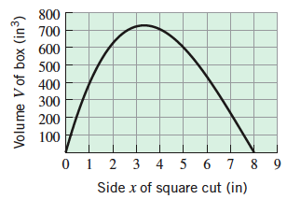
Domain and Range in Applied Problems
Physical considerations often impose restrictions on the domain and range of a function.
Read ex. 9 & 10 on pgs 9 & 10 in your book and we will discuss them more next class.

